Slide 1
How To Safely “Detonate” Suspicious Content
I hope to blow your mind…

Slide 2
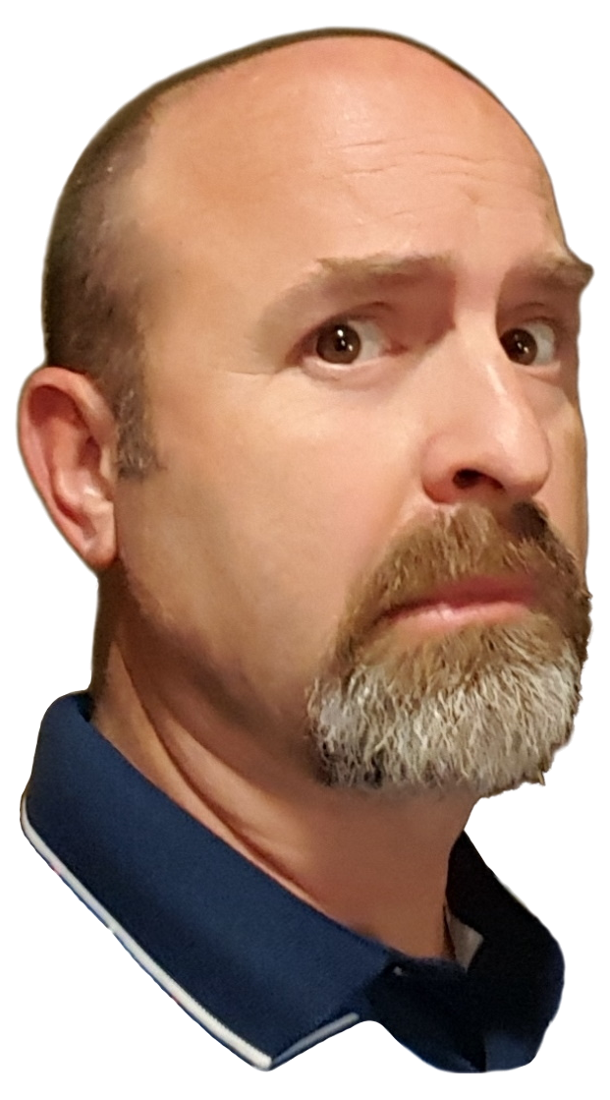
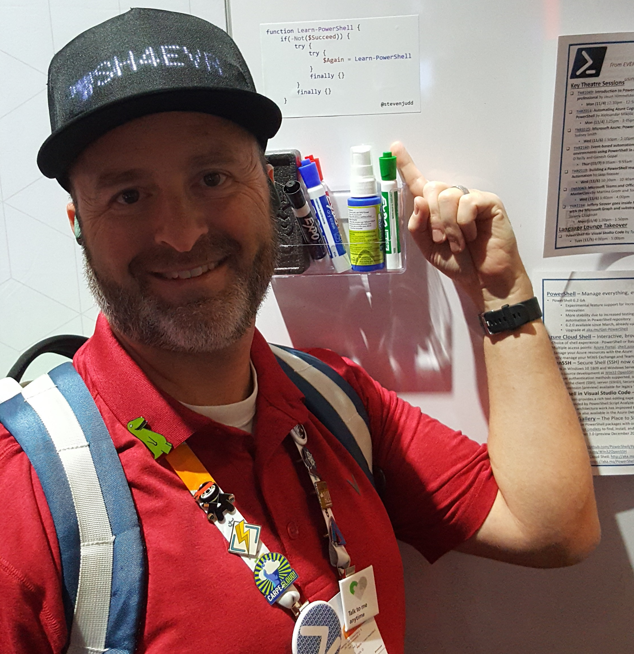
Who Am I?
Steven Judd
Multi-year, multi-discipline IT Pro
PowerShell enthusiast
Dad joke enthusiast
Fashion icon
Maybe not…
Wut?

Slide 3
Why does this talk matter to you?
If you deal with potentially malicious content at all
If you don't have lots of budget
If you just want some ideas

Slide 4
Methods demonstrated
Browser in a container
OS in a container
VM Image

Slide 5
Environment
Windows client
Windows 11
Docker Desktop

Slide 6
Browser in a container
Firefox image
GitHub: jlesage/docker-firefox: Docker container for Firefox (github.com)
DockerHub: jlesage/firefox - Docker Image | Docker Hub
Demo

Slide 7
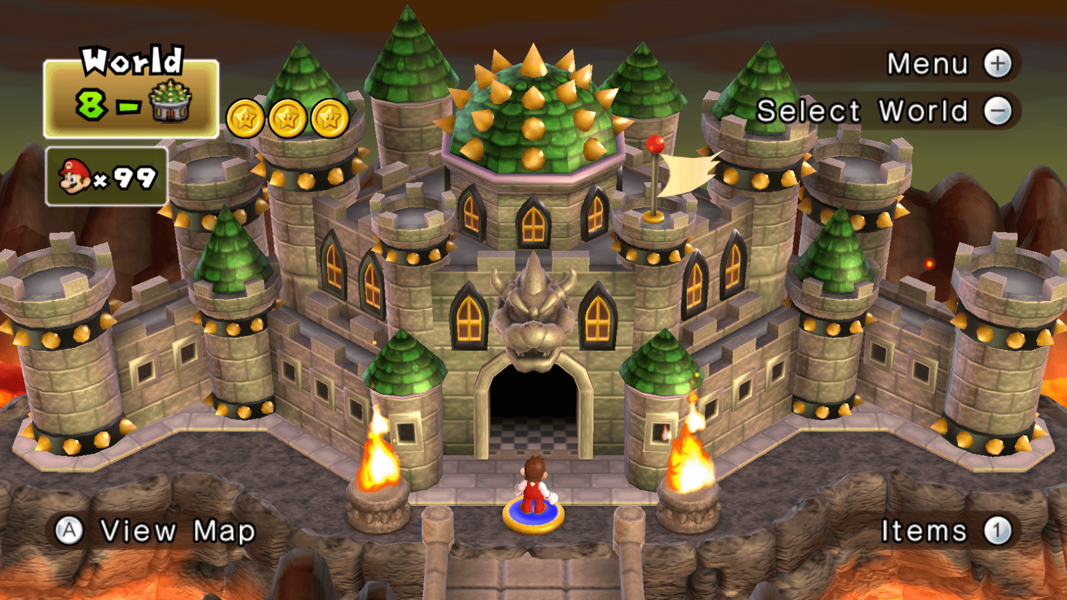
Browser’s Castle Defense
Strengths
Easy/Light/Fast
No risk to host OS
Free
Weaknesses
Container skills required
Only for browser solutions
Hard to move links/files back and forth
Host IP trackable

Slide 8
OS in a container
Windows Services for Linux (WSL) version 2 using Kali
Instructions: How to Install Kali Linux on Windows 11 Using WSL (linuxtechi.com)
Not exactly what I did
Demo

Slide 9
Old McDonald’s image is: Kali I-E-I-O
Strengths
Full OS to examine content
Easy to reset
Free
Weaknesses
Some assembly required (photo of IKEA)
Which you will have to repeat or automate if you reset
Host IP trackable

Slide 10
VM Image
Azure VM
Scripted setup
Scripted removal
Use the cloud/hosting provider of your choice
Demo

Slide 11
VM Image
Strengths
Most compatible (Windows OS)
Easy to reset
Host IP not trackable
Weaknesses
Some cost
Requires Cloud account
Potential red tape

Slide 12
Conclusion
You have 3+ options
Each option has strengths and weaknesses
My preference is the VM image
This is the lighting of the fuse…

Slide 13

Please stay in touch
Twitter: @stevenjudd
LinkedIn: https://www.linkedin.com/in/stevenjudd/
Discord: @juddmissile (no more numbers!)
ICQ: 340799 (I’m not actually on ICQ…)
http://blog.stevenjudd.com (needs CSS help…)
https://github.com/stevenjudd
https://blog.stevenjudd.com/My-Content-List
Notes:
Are there any questions?

